Slide 1
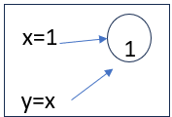
Mutable & Immutable:
Definitions:
Mutable =. value of the variable can be changed.
Immutable = value of the variable cannot be changed
Immutable: string, integer, tuple
Mutable: List, Dictionary
X & Y share same memory location
x=1
x=1
1
1
y=x
y=x
x=11
11
Same memory but value is changed
Y remains in the same location
x=10
10
New memory is assigned to x

Slide 2
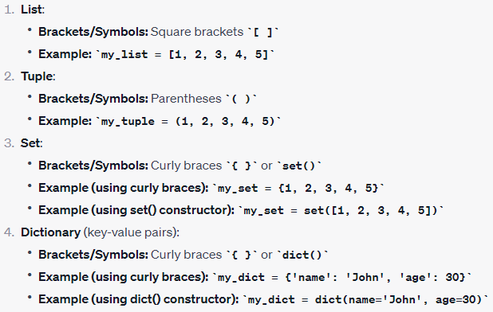
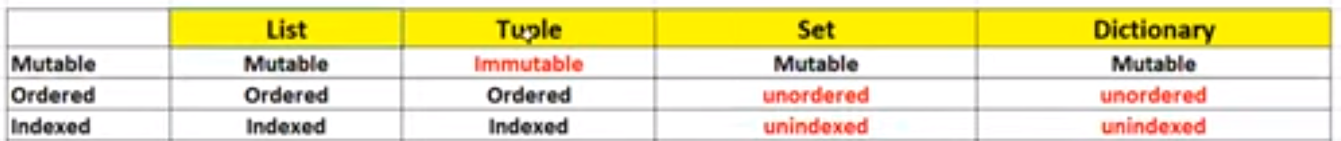
Collections in Python
List: []
Tuple: ()
Set: {}
Dictionary: {}

Slide 3
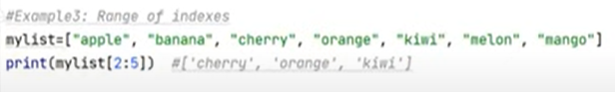
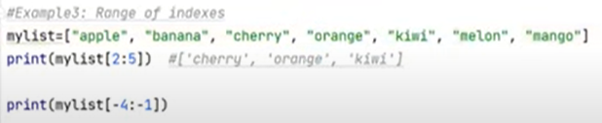
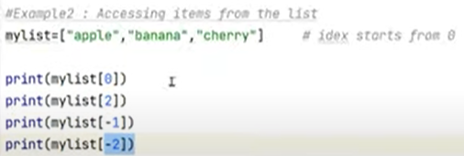
List [] in Python
Use range() to extract:
List is immutable
Data is added in order and is changeable
List is stored within square brackets []
-4: start point is 4th from the end = orange
-1: end point from the end (n-1) = melon
Extract the last item from the list using [-1], [-2] etc..

Slide 4
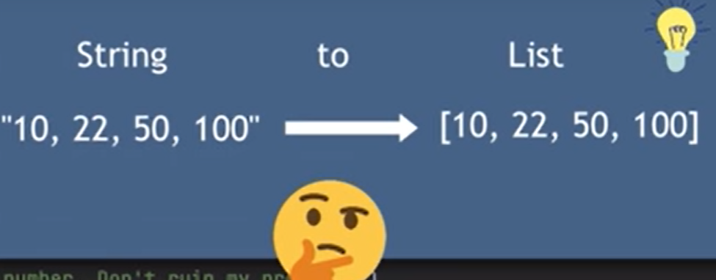
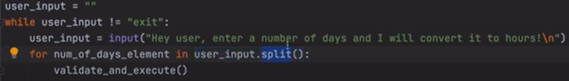
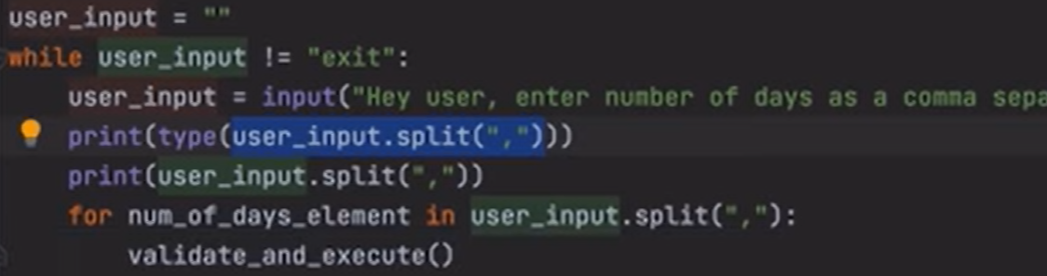
Convert string to a List[] using split()
varList.split()
varList.split(“,”)

Slide 5
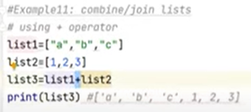
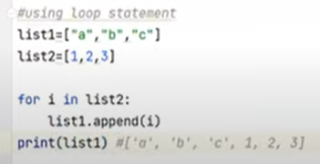
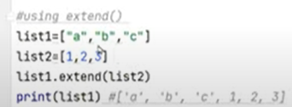
List[] Join/combine in Python
+ operator
For loop – using append() 2nd list to 1st list
Extend()

Slide 6
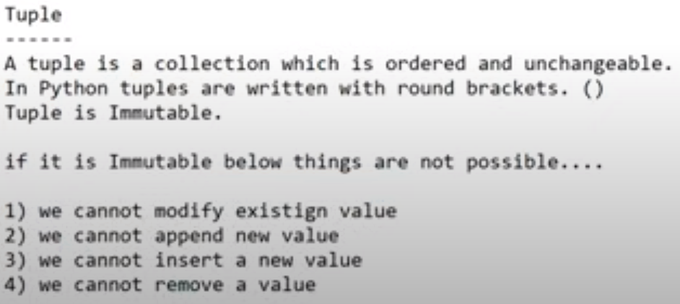
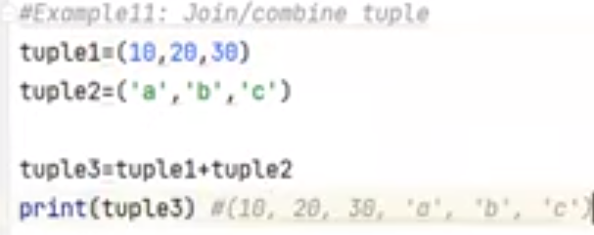
Tuple() in Python
Immutable
Stored in order and NOT changeable
Allows different type of data in Tuple
Round brackets
Note:
Tuple is more secure than the List
Note:
2 Tuples can be concatenated/joined

Slide 7
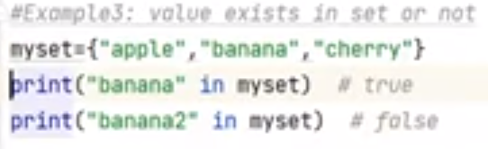
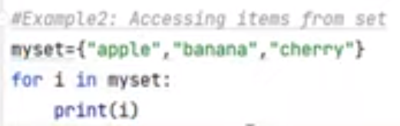
Set{}: test/access/extract value in Python
Set is Mutable
Values are not stored in the same order they are added.
We cannot extract a specific value from a set without using For Loop
Written in {}
Check value exists in Set or not:
Extract from Set:

Slide 8
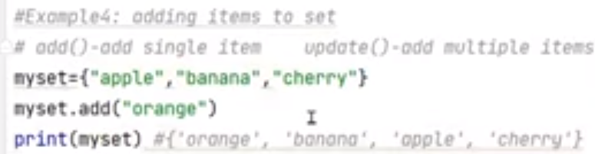
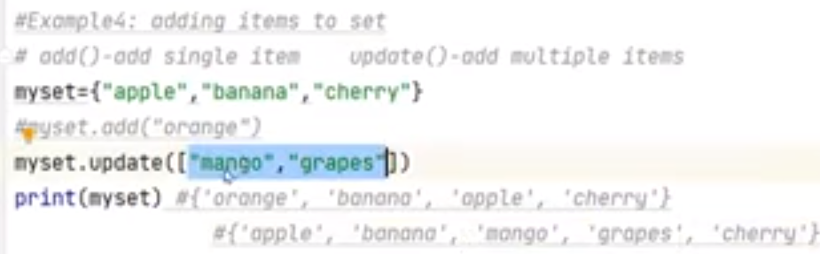
Set{}: Add/Updated in Python
Add() -> adds only single element
Update() -> adds multiple elements

Slide 9
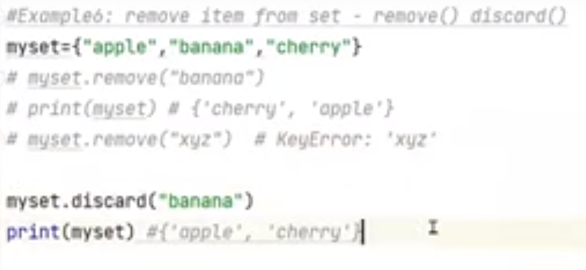
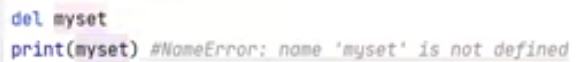
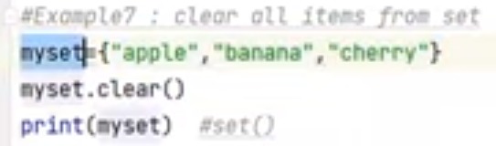
Set{}: remove/discard/clear/del in Python
remove() -> deletes an element
remove() throws error when non-listed items is requested.
discard() -> deletes an element
but does not throw any error when items is not listed
del command deletes the set
clear() empties the items in the set

Slide 10
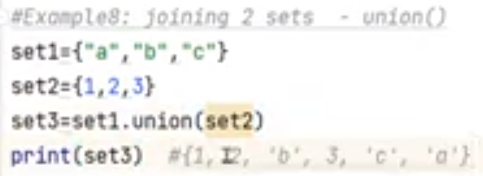
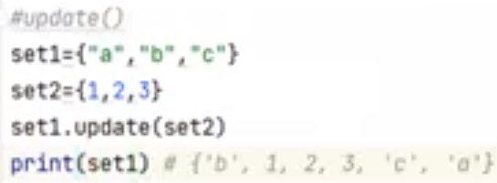
Set {}: join in Python
union() -> joins 2 sets but not in order
update() also adds

Slide 11
Dictionary{} (Hash-Map in java) in Python
Dictionary is Mutable
Values are not stored in the same order they are added.
Written in {}

Slide 12
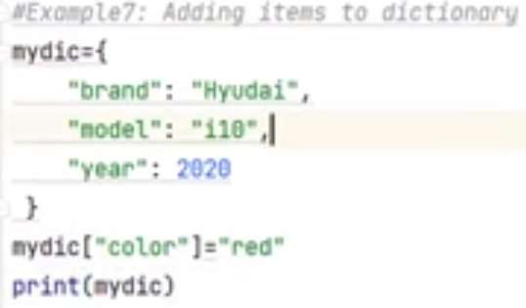
Dictionary{}: To add [Keys] = value in Python
add keys & value

Slide 13
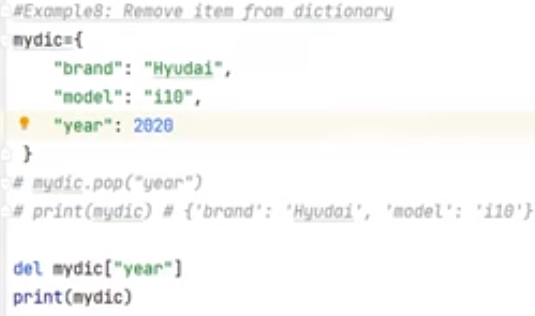
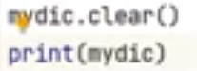
Dictionary{}: to remove Keys & it’s value in Python
pop()
del
clear()
pop() -> deletes key & it’s value
del command -> deletes key & it’s value
Clear() -> empties the dictionary
del dictionaryname-> deletes the dictionary

Slide 14
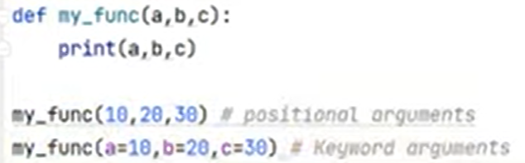
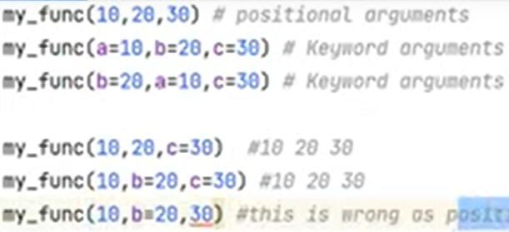
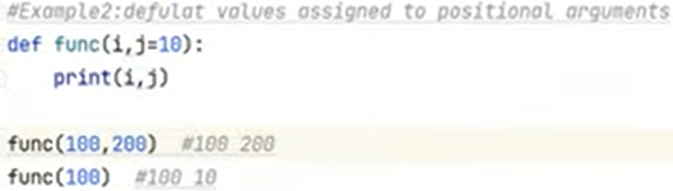
Function: Arguments/ parameters in Python
Rule-> positional argument must appear before the keyword argument
Argument passed in the calling function will override the keyword parameter defined in the defined function
This is also not valid.
30 is already in b
b is again assigned 20
That’s why it’s not valid

Slide 15
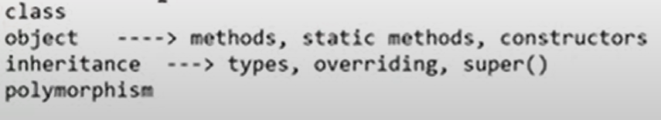
Structure & Object Oriented language - Python
Java is only Object Oriented programming language
Python is structure + Object oriented programming language
OOPS (Object Oriented Programming Concepts)
Class
Object
Inheritance
Overloading/ polymorphism
Class = categories -> are logical entities eg: Employees, Animals, Birds ..
Collection of variables (attributes) & methods (behavior)
Memory-> It is only a blueprint and that’s why it does not occupy any space in the memory
Object = physical entities eg: Employees John, Scott, Marry … // Animals Dog, horse, elephant…
Every object created from class will acquire it own set of variables & methods as defined in class
From one Class many objects can be created
An object is an instance of a class
It is physical entity
It occupies space in the memory
In the object, the values (attributes) of each of the variables & methods derived from the class will be different in each objects
Each objects are independent of each other

Slide 16
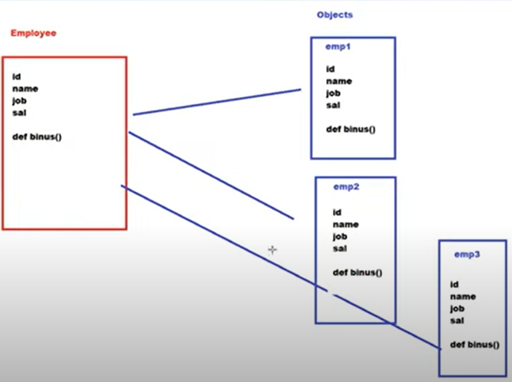
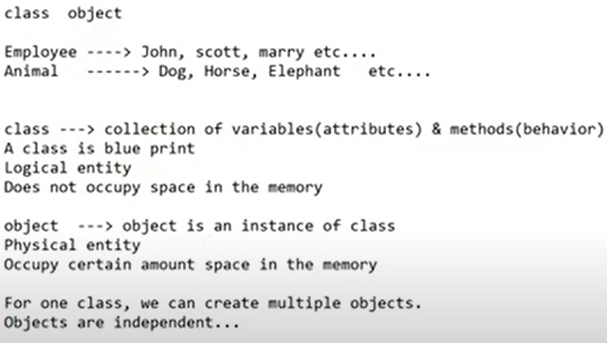
Class & Objects

Slide 17
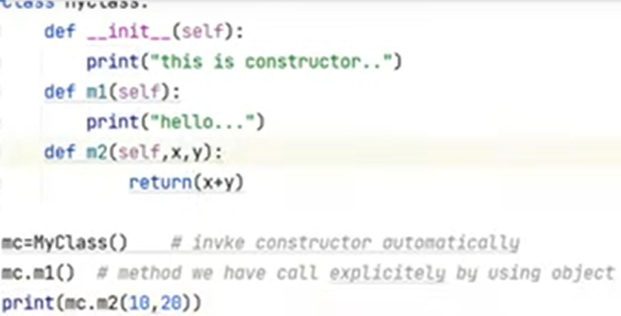
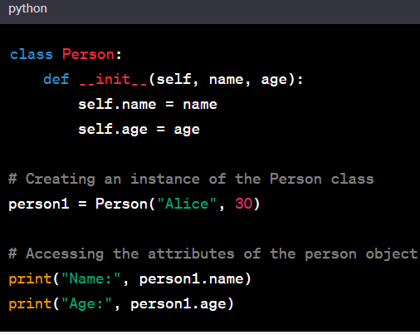
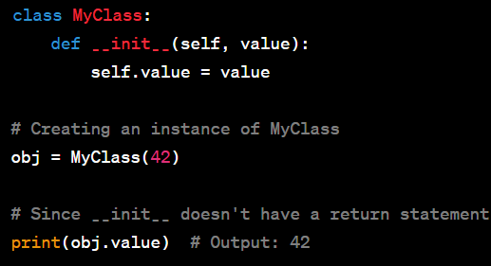
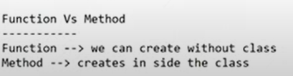
Function vs Method vs Constructor
Method
functions created inside a class
Give any name
Returns value/s
Takes arguments/parameters
Invoked through Object of a class
2 types of methods:
Instance method (we can call only through Object)
Static method (we directly call using Class) –annotation @staticmethod
Constructor
Constructor name is fixed: def __init__(self): Do not return any value
Constructor name is fixed: def __str__(self): only used to return string datatype.
def __intit__(self): no values returned
def __str__(self): only string values are returned
Takes arguments/parameters
Invoked automatically when a object of this class is created.
Functions are created without any class
Functions created in a class is known as Method !!!

Slide 18
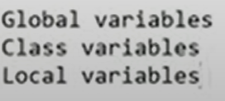
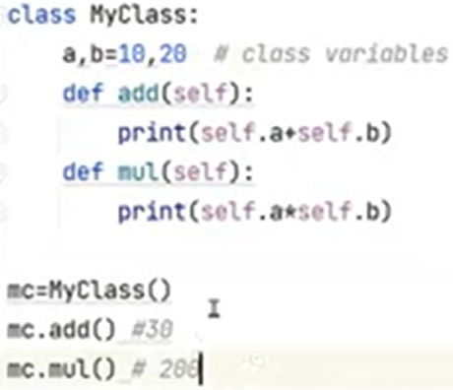
Class variables
Class variable: are not global so they cannot be accessed without self

Slide 19
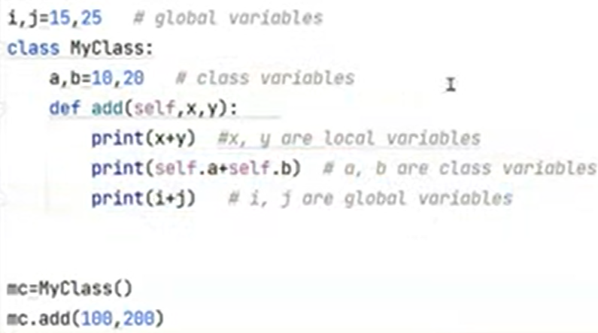
Global - Class - Local variables
x, y are local vars
a, b are class vars
i, j are global vars
Calling method passed arguments to local variables

Slide 20
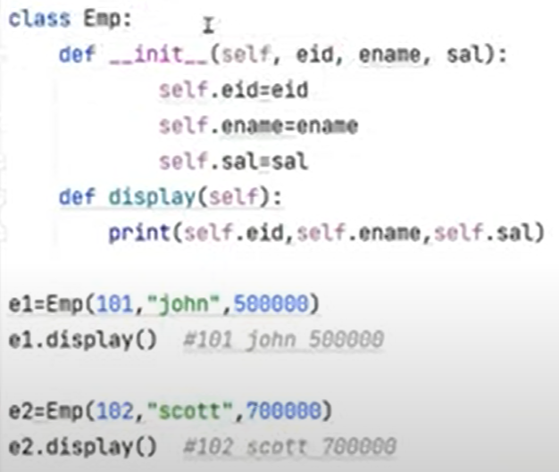
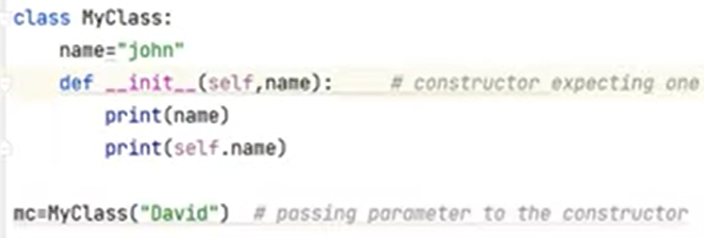
constructor- Class
https://youtu.be/CGmh7hq3gZM?si=18N_SHIHIpYjRfnM
def __init__(self): Do not return any value
self is used to create class variables inside the constructor.
It is similar to using global keyword to create global variable inside a method/function.
Constructor with parameter
Local variable
self used to use class variable
Constructor Argument is passed in the class name

Slide 21
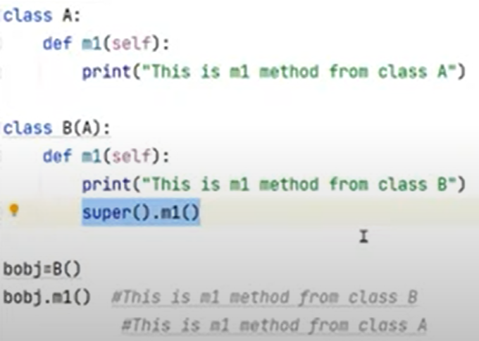
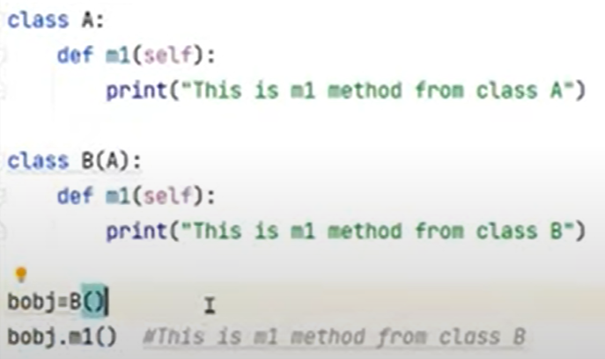
Super().. Inheritance – Class continued…
https://youtu.be/CGmh7hq3gZM?si=18N_SHIHIpYjRfnM
Objective
Code reusability
Avoid duplication
Super () keyword to invoke parent class method
Default -> Method of latest implementation will be used i.e B
Super() -> Method of parent class using Super()
Super () keyword to invoke parent class method

Slide 22
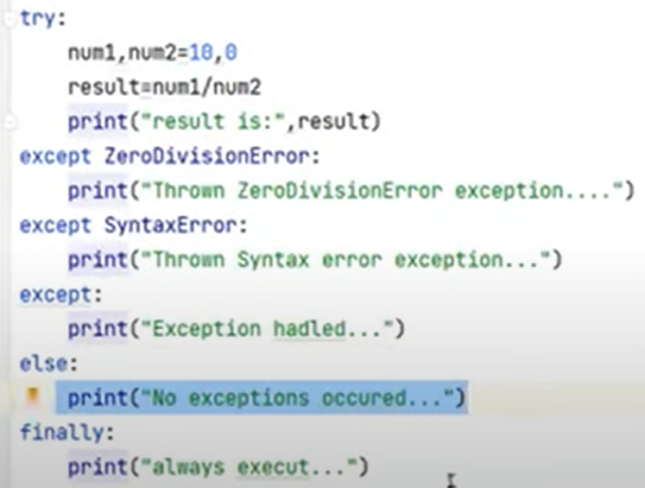
Try, <except or else>, finally
except or else
except block executes – no Else execution
no except block executes – Else will execute.
Finally block is Always Executed

Slide 23
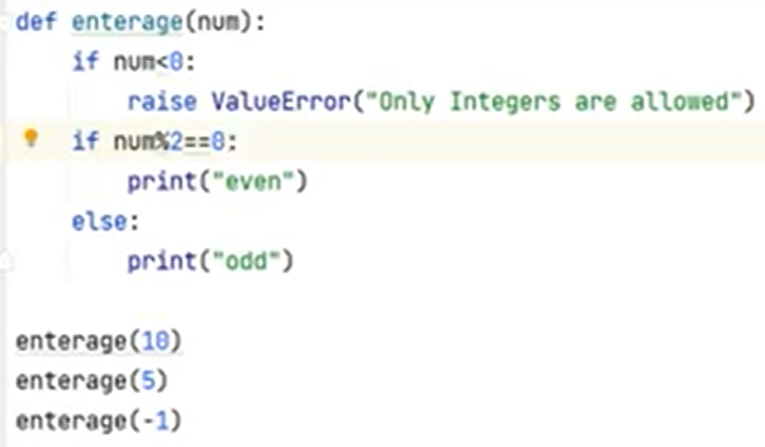
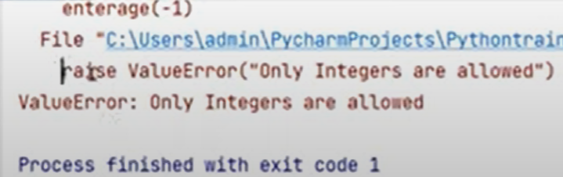
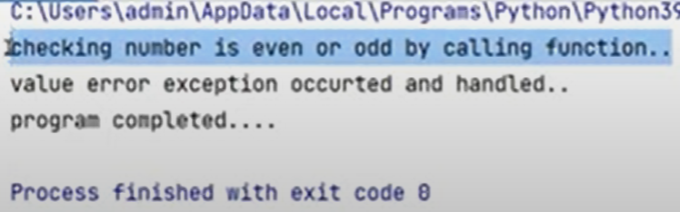
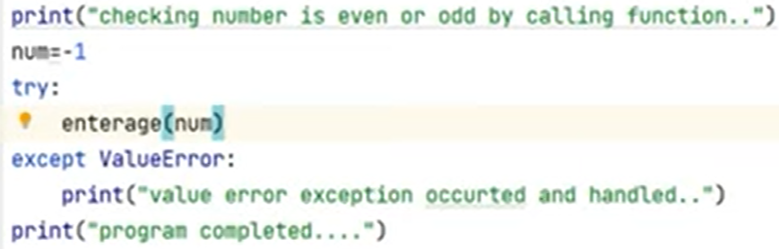
raise <user defined exception>
raise User defined exception
Calling enterage()

Slide 24
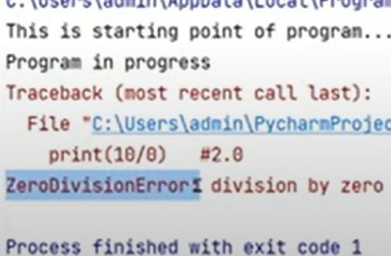
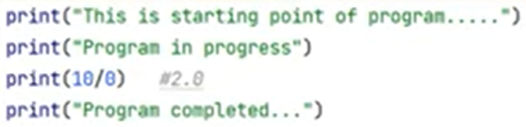


Try, except
except: leave it empty, if you don’t remember name
except: exception name

Slide 25




File Handling / Text file
Open(), write(), close()
Open(“…”,’w’) & write() – prints the text in the file
Open(“…”,’r’) & read() – reads entire file
Open(“…”,’r’) & readline() – reads 1st line in the file
Open(“…”,’a’) & write() – appends the text in the file

Slide 26
1. Create new Project & Install required packages/plugins
Selenium: selenium libraries
Pytest: Python Unit Test framework
Pytest-html: PyTest HTML, Report
Pytest-xdist: Run Tests Parallel
Openpyxl: MS Excel Support
Allure-pytest: to generate allure reports

Slide 27
Steps:
Create new Project & Install required packages/plugins
Create folder structure
Automating Login test case
Capture screenshot on failures & as called by the user.
Read common values from ini file
Adding logs to test cases
Run tests on Desired browser/cross browser/parallel

Slide 28
diff btwn selenium.webdriver & selenium import webdriver
import selenium.webdriver, imports the entire webdriver module from the Selenium library.
allows access to various submodules and classes within the webdriver module directly.
work with different web drivers
selenium import webdriver imports just the webdriver module from the Selenium library.
This method is convenient if you primarily use a single web driver (e.g., Chrome)
primarily used for one web driver in your code.

Slide 29

Driver basics with new version
executable_path is not required in the new selenium
If Selenium finds the driver executable in the PATH, it will use it to launch the browser. If it doesn't find the driver executable, it will raise an exception.
Selenium WebDriver has a built-in mechanism to search for the browser drivers in the system's PATH by default. When you create a webdriver.Chrome() or webdriver.Firefox() instance without specifying an explicit driver path, Selenium will look for the appropriate driver executable (chromedriver or geckodriver) in your system's PATH environment variable.

Slide 30
Driver basics with new version
executable_path is not required in the new selenium
If the system environment variables do not include the paths to the browser drivers.
Some browsers, like Google Chrome and Mozilla Firefox, include their respective drivers as part of the browser installation. In such cases, if you have Chrome or Firefox installed on your system, Selenium can find the drivers within the browser's installation directory. This is particularly common with Chrome.

Slide 31

if browsers & raise to catch exception
raise ->
<- raise execution is terminated

Slide 32

driver.find_element(By. XPATH/ NAME, ‘…’)
XPAT locator ->

Slide 33

Create a method for Dropdown Select()
Define one method to handle all dropdowns
Functions are called as many times as needed with arguments

Slide 34



Generic Dropdown List, single value, all values …continued
If ‘all’ is passed then click on all options
Generic function to accept:
List
Single value
All values in the dropdown
Range() works on both List & single value
‘All’ argument is passed to this function.

Slide 35


Mouse: ActionsChains -> move_to_element(element)
Mouse function to hover and click

Slide 36

Mouse: ActionChains -> dragAndDrop(element)
Both elements
1st option: drag_and_drop(source, target)
2nd Option: Click_and_hold()….move_to_ele…release()…

Slide 37

Mouse: ActionChains -> sendkeys .. Enter an input value
Send keys to enter input vapue

Slide 38


Wait …. explicitly wait list→ presence_of_all_elements_located((locator))
Explicitly wait examples:
WebDriverWait: max time to wait
wait.until(expected cond is met)
wait.unit(presence_of_all_elements_located())
Video: https://youtu.be/iOpGGW__oz4?si=1Ks2O783GsjNAy3S

Slide 39


Wait …. explicitly wait → presence_of_element_located((locator))
Explicitly wait examples:
WebDriverWait: max time to wait
wait.until(expected cond is met)
wait.unit(presence_of_element_located())
Video: https://youtu.be/iOpGGW__oz4?si=1Ks2O783GsjNAy3S

Slide 40

Read Excel – xlrd package: pip install xlrd

Slide 41




Data Driven – Read Excel in Python
UI locators & variables
Command to read excel
send_keys the data to UI

Slide 42

driver.find_element(By.Name, ‘…’)
From selenium.webdriver.common.by impot By
find_elements(By.CSS_SELECTOR, ‘…’)
For loop to print List
List of elements
Loop to print list

Slide 43

Ways to run python code: scriptname.py
Run python code through IDLE provided by python on installation
Run python code through cmd window
Run python code through notepad/notepad++
---------------------------------------------------------
Editors with autosuggestion, error catcher, console output
PyCharm

Slide 44
2. Create folder structure
Project Name
Page Objects(package)
testCases(package)
Utilities(package)
TestData(folder)
Configurations(folder)
Logs(folder)
Screenshots(folder)
Reports(folder)
Run.bat <- to execute all in one shot.

Slide 45


1. Fixture(scope=‘class’) in Pytest
test_fixture_params.py
webdriver.Firefox()
‘init__driver’ = not a constructor nor object initializer.
it is fixture name given & defined by the user & is not built-in.
user has defined this method to:
it initializes a WebDriver based on the parameter passed to it.
It configs & returns a WebDriver for either Chrome or Firefox.

Slide 46
2. Fixture(scope=‘class’) in Pytest
params = List is hardcoded in this eg
loop = till all elements in the list are executed
test_fixture_params.py
Fixture(params = List is passed
request as parameter
request=parameter name
.cls= class
.driver=driver
driver not initialized as global
Parent class
‘init__driver’ provides the driver to the calling class.
Child class
child inherits the driver from the parent
Execution:

Slide 47
@pytest.fixture(param=[“chrome”, “firefox”], scope=‘class’)
params is a parameter of the @pytest.fixture decorator.
It is used to specify a list of values that will be used as arguments to the fixture function when it is invoked.
In the given example, params is set to ["chrome", "firefox"], which means that this fixture will be called twice: once with the argument "chrome" and once with the argument "firefox".
Pytest will automatically generate multiple test runs, one for each value in the params list, and the fixture will be invoked with each value during those test runs. This is often used when you want to run the same set of tests with different inputs.
In the example, the fixture is given a scope='class'. This means that the fixture will be created once for the entire test class. If you have multiple test methods within the same test class that use this fixture, they will all share the same instance of the fixture, which can be useful for sharing setup and teardown code or expensive resources across multiple test methods within the same class.
A scope determines the lifetime or scope of the fixture, i.e., how long the fixture should be in effect during the test run.
In Pytest, there are several possible values for scope, including 'function', 'class', 'module', and 'session'.
The choice of scope affects when the fixture is set up and torn down:
'function' (default scope):
The fixture is created and destroyed for each test function that uses it. This means a new instance of the fixture is created before each test function and destroyed after the test function completes.
'class':
The fixture is created and destroyed once for the entire test class. All test methods within the class share the same instance of the fixture.
'module':
The fixture is created and destroyed once for the entire test module. All test functions and classes within the same module share the same instance of the fixture.
'session':
The fixture is created and destroyed once for the entire test session. All test modules, classes, and functions within the entire test session share the same instance of the fixture.

Slide 48


Conftest.py file must be created
fixture name in this eg: init__driver(request)
this fixtue will behave like a global precondition for all test classes
Conftest.py
TestRough1.py

Slide 49
Fixtures & Conftest.py
Fixture Sharing: One of the primary uses of conftest.py is to define fixtures that can be reused across multiple test files.
Fixtures are functions that set up and tear down resources or states needed for tests.
By defining fixtures in conftest.py, you make them accessible to all test files within the same directory and its subdirectories.
This promotes code reuse and maintains consistency across tests.

Slide 50

@pytest.mark.parametrize("param1, param2, ...", [...])
() This is the decorator that marks the test function for parameterization.
Inside the parentheses, you specify the names of the parameters the test function will receive
(e.g., param1, param2, etc.)
([...]) Within the square brackets, you provide a list of tuples.
Each tuple represents a set of parameters and their corresponding values.
Each tuple should match the number and order of parameters defined in the decorator.
The test function will run three times, once for each set of parameters

Slide 51

Parametrize example
driver is passed
Execution:

Slide 52
POM
https://youtu.be/qBK5I_QApCg?si=-8oCWOLFoBGYjmn5
test_LoginPage
BasePage
LoginPage
calls BaseTest
class Test_Login(BaseTest)
comes with driver
list of tests:
test_signup_link_visible(self)
creates LoginPage object
invokes LoginPage methods (self.driver)
calls TestData values to pass param to the LoginPage methods
constructor that asks for driver as parameter
generic Methods:
click
send_keys
get_text
get_title
is visible
calls BasePage
Locators of UI elements defined
constructor
asks for webdriver as parameter
gives webdriver to BasePage(super)
Launches the URL
Methods:
do_login()
check_SignUp()
check_title() & return true/false
webdriver
BaseTest
calls the fixture to get WEBDRIVER
config.py
TestData: variables & values
conftest.py
fixture that initializes and returns a live webdriver

Slide 53





POM
https://youtu.be/qBK5I_QApCg?si=-8oCWOLFoBGYjmn5
test_LoginPage
LoginPage
webdriver
BasePage
calls BasePage
Locators of UI elements defined
Constructor()
Methods:
do_login()
check_signup_link_exits()
check_title() & return true/false
constructor that asks for webdriver as parameter
generic Methods:
click
send_keys
get_text
get_title
is visible
webdriver
webdriver
BaseTest.py
webdriver
Config.py
Conftest.py

Slide 54


Unittest vs Pytest

Slide 55
"""===== modified youtube code with chatgpt suggestion: =====""" @pytest.hookimpl(hookwrapper=True) def pytest_runtest_makereport(self, call): pytest_html = self.config.pluginmanager.getplugin('html') outcome = yield report = outcome.get_result() extras = getattr(report, "extras", []) if report.when == "call" or report.when == "setup": xfail = hasattr(report, "wasxfail") if (report.skipped and xfail) or (report.failed and not xfail): file_name = report.nodeid.replace("::", "_") + ".png" self._capture_screenshot(file_name) if file_name: # Corrected the HTML code to open the image in a new window html = ('<div><a href="{0}" target="_blank">' '<img src="{0}" alt="screenshot" style="width:304px;height:228px;" />' '</a></div>').format(file_name) extras.append(pytest_html.extras.html(html)) print(extras) #report.extras = extras def _capture_screenshot(self, image_name): self.driver.get_screenshot_as_file(image_name) def pytest_html_reprot_title(self, report): report.title = "Automation Report" """===== 1. https://youtu.be/MM6axmqAKWM?si=dMGNCDthimlNJAkj code: =====""" """ @pytest.hookimpl(hookwrapper=True) def pytest_runtest_makereport(item, call): outcome = yield report = outcome.get_result() extras = getattr(report, "extras", []) if report.when == "call" or report.when == "setup": xfail = hasattr(report, "wasxfail") if (report.skipped and xfail) or (report.failed and not xfail): file_name = report.nodeid.replace("::", "_") + ".png" _capture_screenshot(file_name) if file_name: html = '<div><img src=%s alt="screenshot" style="width:304px;height:228px;" ' \ 'onclick-window.open(this.src)" align="right"/></div>' %file_name extras.append(pytest_html.extras.html(html)) report.extras = extras # always add url to report extras.append(pytest_html.extras.url("http://www.example.com/")) # only add additional html on failure extras.append(pytest_html.extras.html("<div>Additional HTML</div>")) report.extras = extras # this method will take a screenshot: def _capture_screenshot(self, image_name): self.driver.get_screenshot_as_file(image_name) # this method will give report name: def pytest_html_report_title(report): report.title = "My very own title!" """ """================ 2. Below is chatGPT code: =======================""" def pytest_runtest_makereport(self, item, call): report = super().pytest_runtest_makereport(item, call) if report.when == "call" and report.failed: # Capture a screenshot when the test fails screenshot_name = item.name + ".png" screenshot_path = os.path.join("Reports", screenshot_name) self.driver.save_screenshot(screenshot_path)

